Slide 1
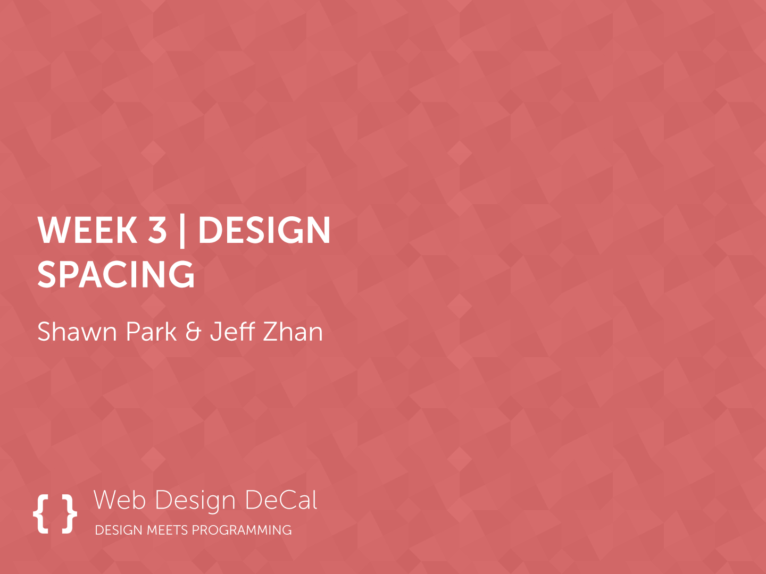

Slide 2

Previous Class
Web Inspector allows you to design CSS and preview it as you write (and more!)
Design Cycle:
Design => Prototype => Evaluate
The purpose of design is to bring order to complexity
…through emphasizing important elements
… using spacing, typography & images, positioning, and color

Slide 3

Today
First pillar of emphasis: Spacing
Macro-level spacing
Micro-level spacing
Applying spacing with CSS

Slide 4

Emphasis
GOAL:
Bring order to complexity by emphasizing important elements
Notes:
A goal of a user interface is not to just please the eye, but to improve the overall usability of a product
Art can be used to improve the efficiency of a product (Art ⬄ Efficiency)

Slide 5
Four pillars for Emphasis
Emphasis
Spacing
Position
Typography
Color

Slide 6

What’s wrong with these UIs?

Slide 7
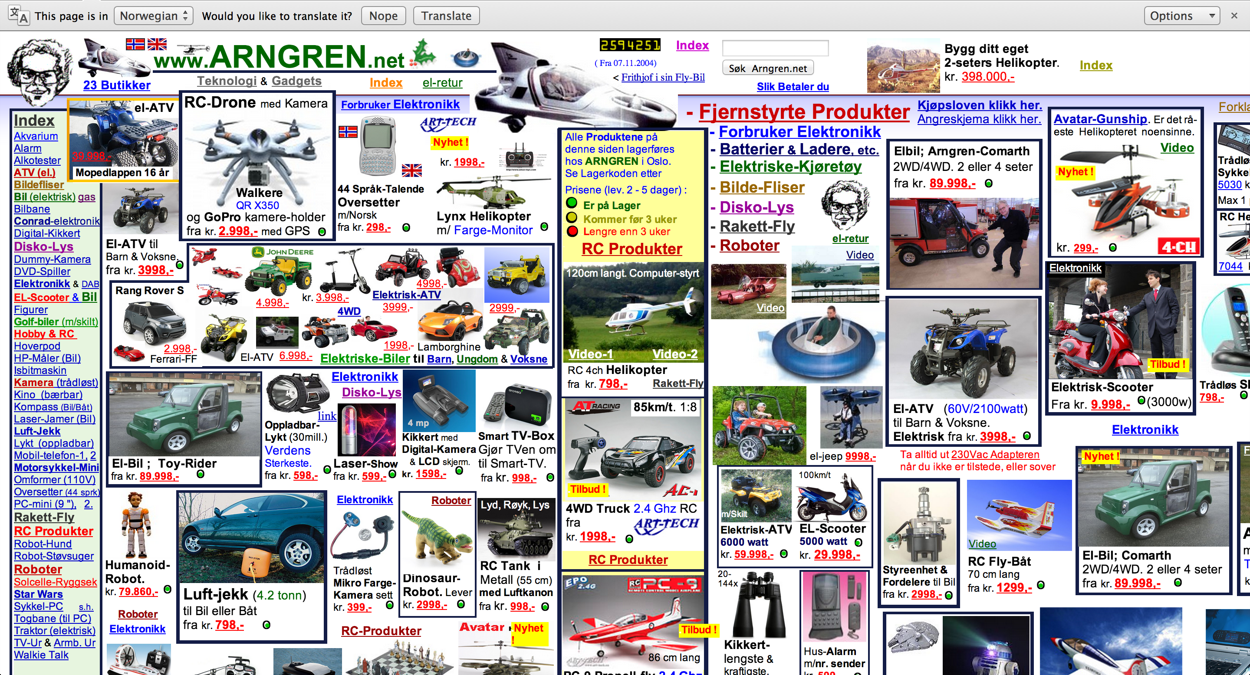
Arngren
Notes:
JS-equivalent of the elements tab
Try out a code before actually going into the code editor

Slide 8

World of Warcraft (with a bunch of plugins)
Notes:
JS-equivalent of the elements tab
Try out a code before actually going into the code editor

Slide 9
Spacing
Spacing makes or break a user interface
Not a good idea to stuff in as much information as possible in a given space
A common argument: “Users won’t see that much content”
A counterargument: Quality of UX > Quantity of UX
Spacing establishes hierarchy of information
Direct user’s attention to a piece of information

Slide 10
Spacing
Positive Space: Space filled up by content
Negative Space (White Space): An empty space
Space between positive space (UI elements)
Helps to define content in a positive space (Creates emphasis)

Slide 11

A Vase or Two Faces?
Notes:
JS-equivalent of the elements tab
Try out a code before actually going into the code editor

Slide 12
Macro-level Spacing
Use Macro-level Spacing to give structure to your interface
Ensure that there is a significant amount of “room to breathe” between each UI element
Give more room (white space) for a UI element to give it more emphasis
Give less room to reduce emphasis

Slide 13
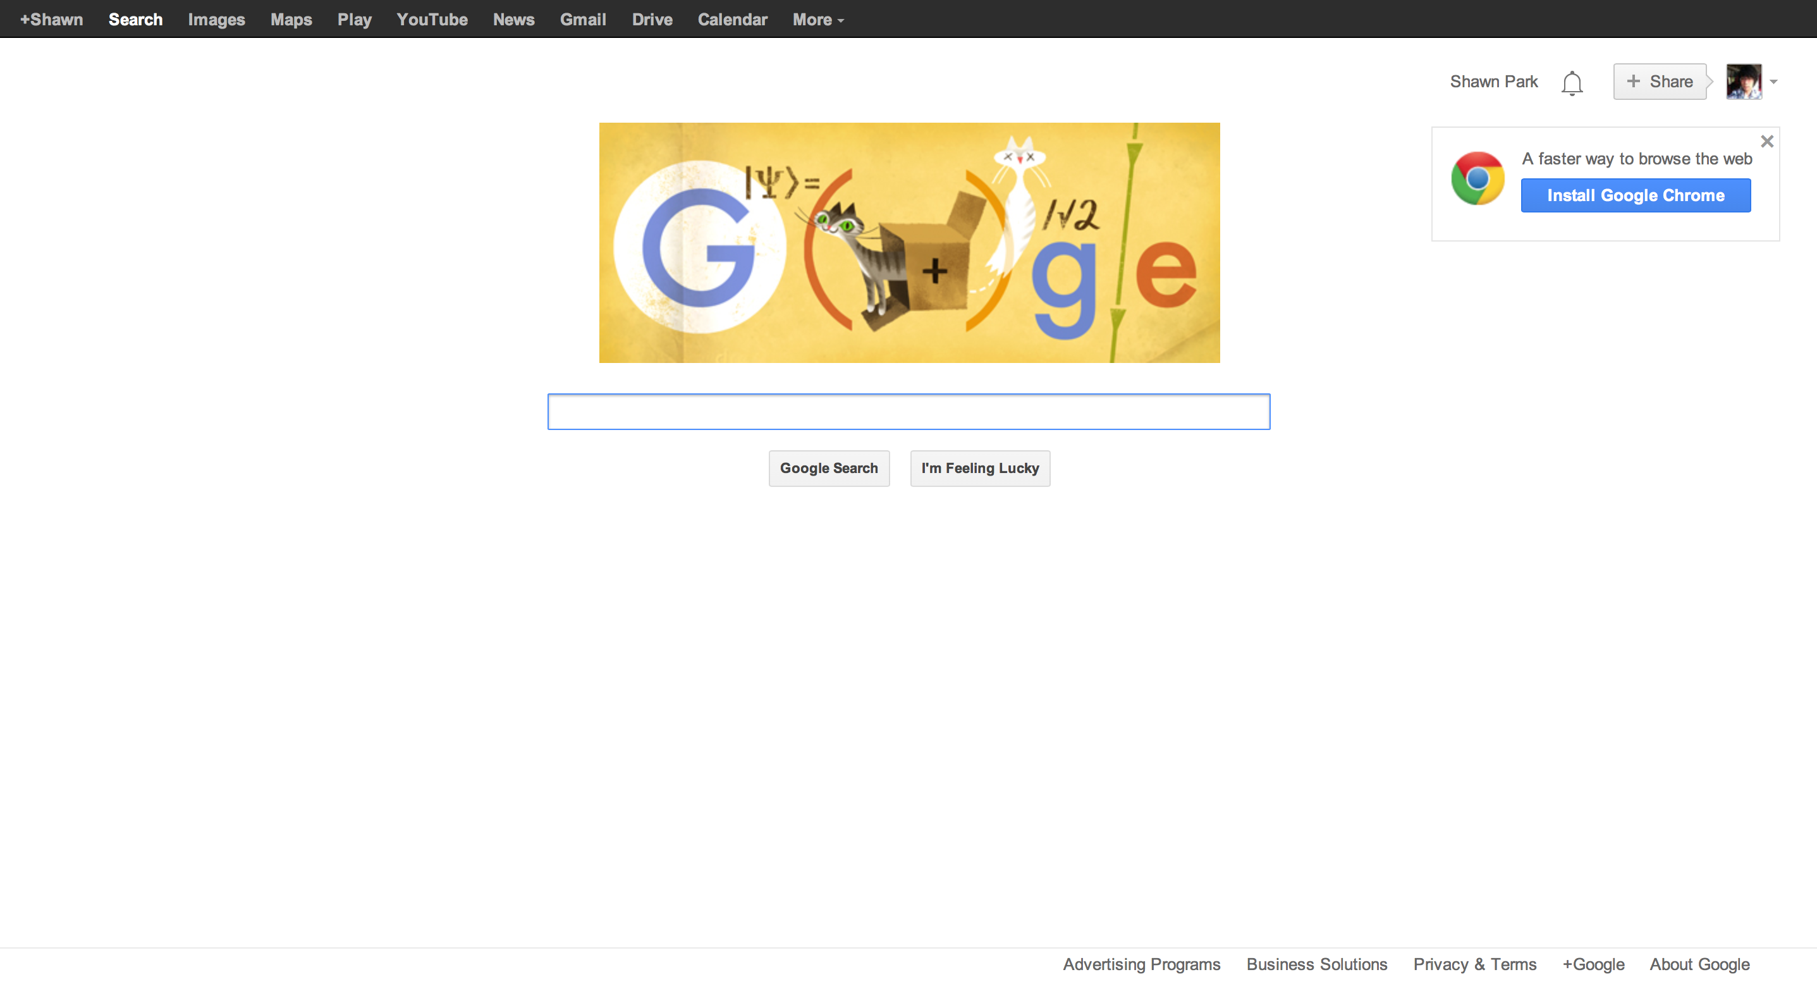
Google
Notes:
JS-equivalent of the elements tab
Try out a code before actually going into the code editor

Slide 14

The Industry
Notes:
JS-equivalent of the elements tab
Try out a code before actually going into the code editor

Slide 15
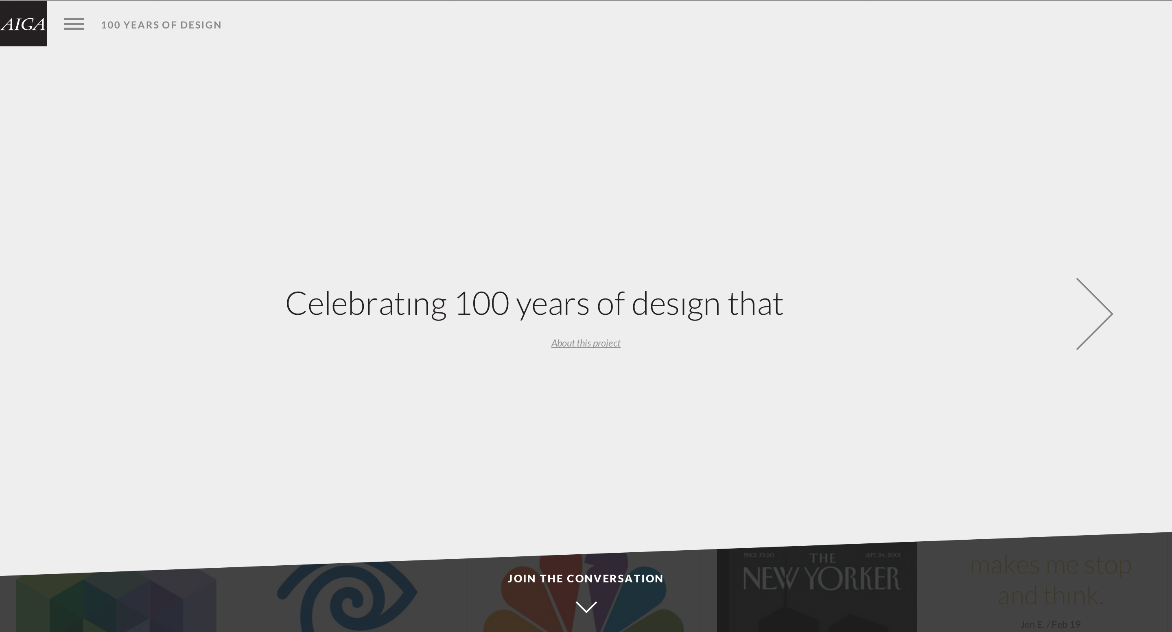
AIGA 100 Years of Design
Notes:
JS-equivalent of the elements tab
Try out a code before actually going into the code editor

Slide 16
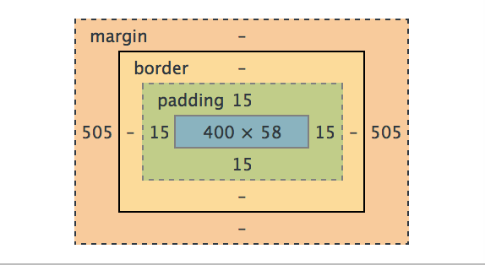
Macro-level Spacing in HTML5/CSS3
CSS Box Model allows you to accomplish spacing in web design

Slide 17
Macro-level Spacing in HTML5/CSS3
Each UI element should have some padding in order to draw emphasis & define its purpose.
When to use padding: If spacing deserves to be in its own element (give emphasis to a single element)
Ex.: Button
When to use margin: If spacing deserves to be between elements (give separation for different elements)
Ex.: Separation between articles

Slide 18
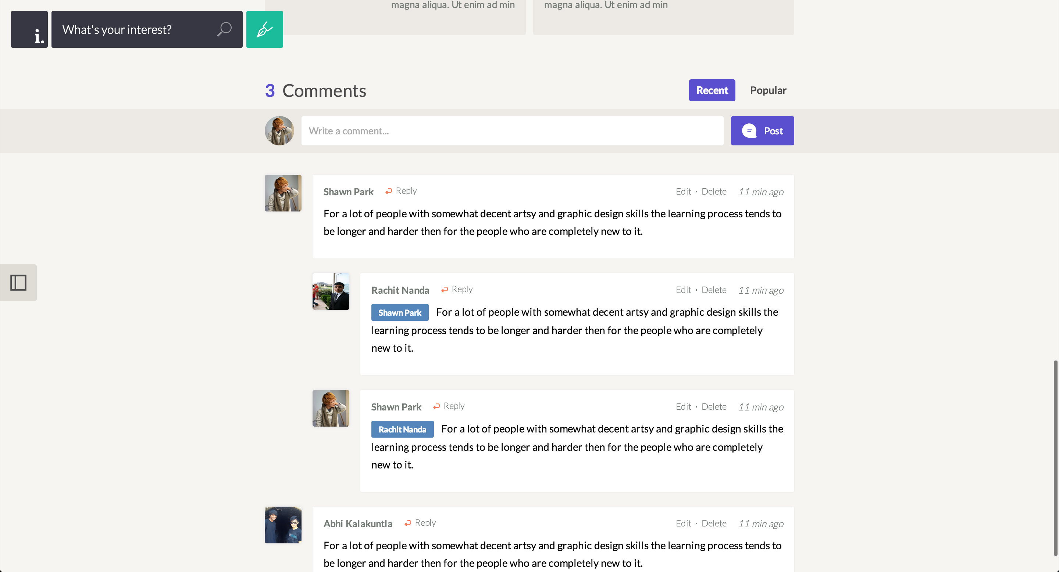
Padding
Margin
Padding vs. Margin
Notes:
JS-equivalent of the elements tab
Try out a code before actually going into the code editor

Slide 19
Example: A Button
All you need to create a button is an appropriate sense of spacing

Slide 20
Micro-level Spacing
Use micro-level Spacing to increase legibility of the text
Accomplished through “line spacing” and “letter spacing”
Extremely useful for text-heavy websites like blogs

Slide 21
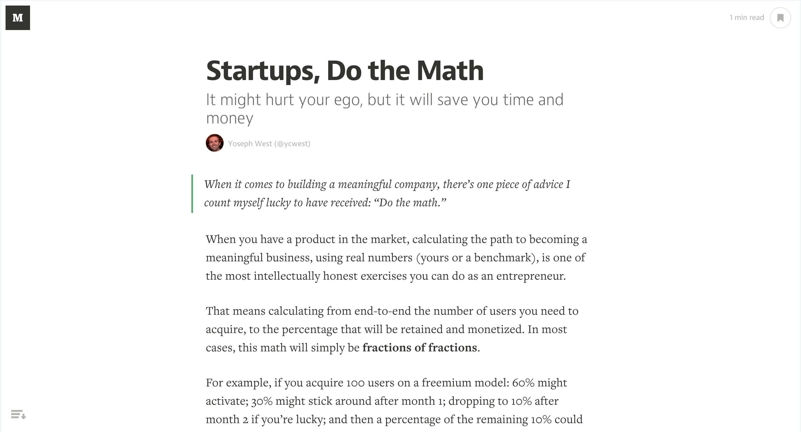
Medium
Notes:
JS-equivalent of the elements tab
Try out a code before actually going into the code editor

Slide 22
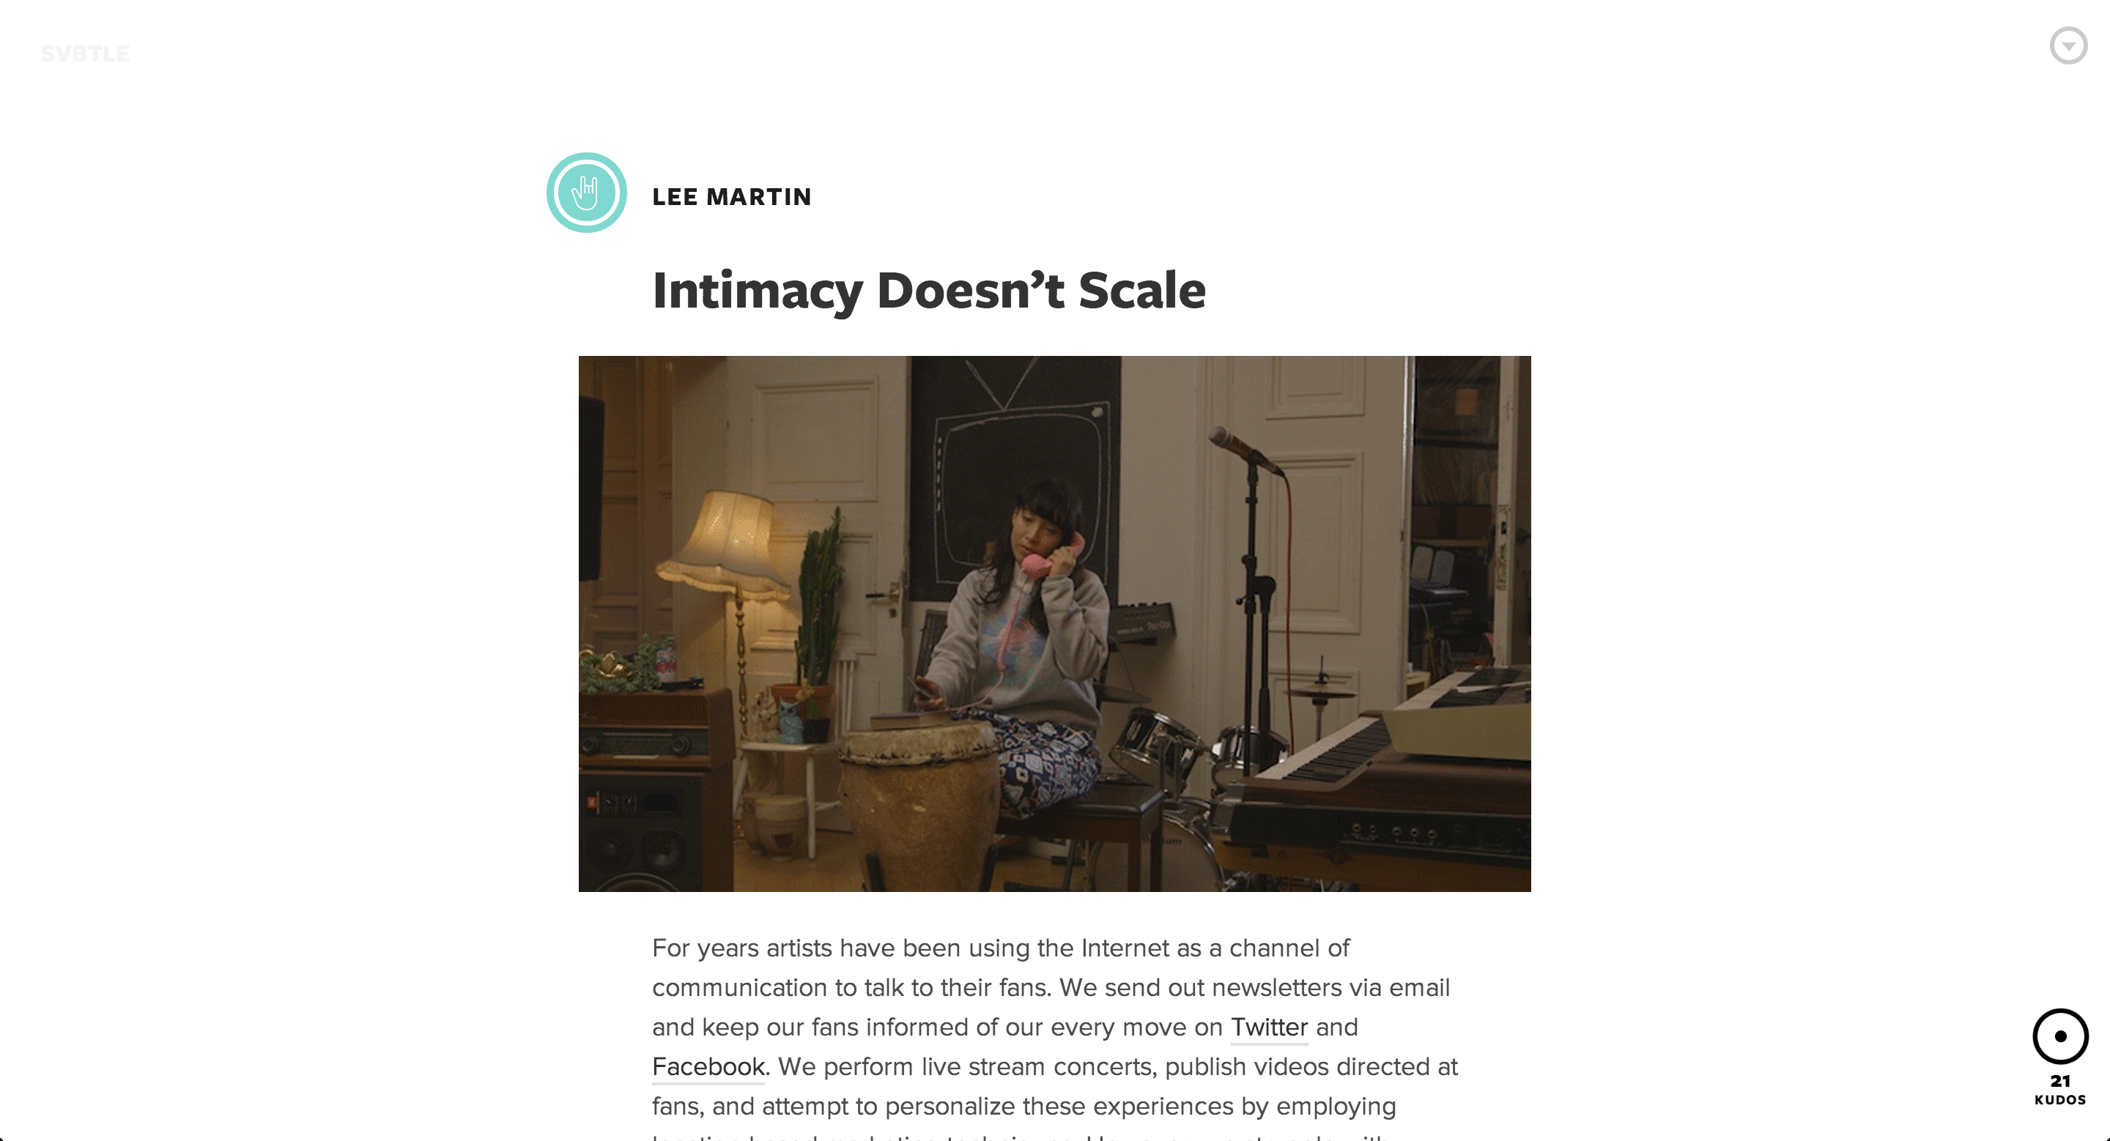
Svbtle
Notes:
JS-equivalent of the elements tab
Try out a code before actually going into the code editor

Slide 23
Micro-level Spacing in HTML5/CSS3
Line-height CSS property makes or breaks the legibility of text

Slide 24
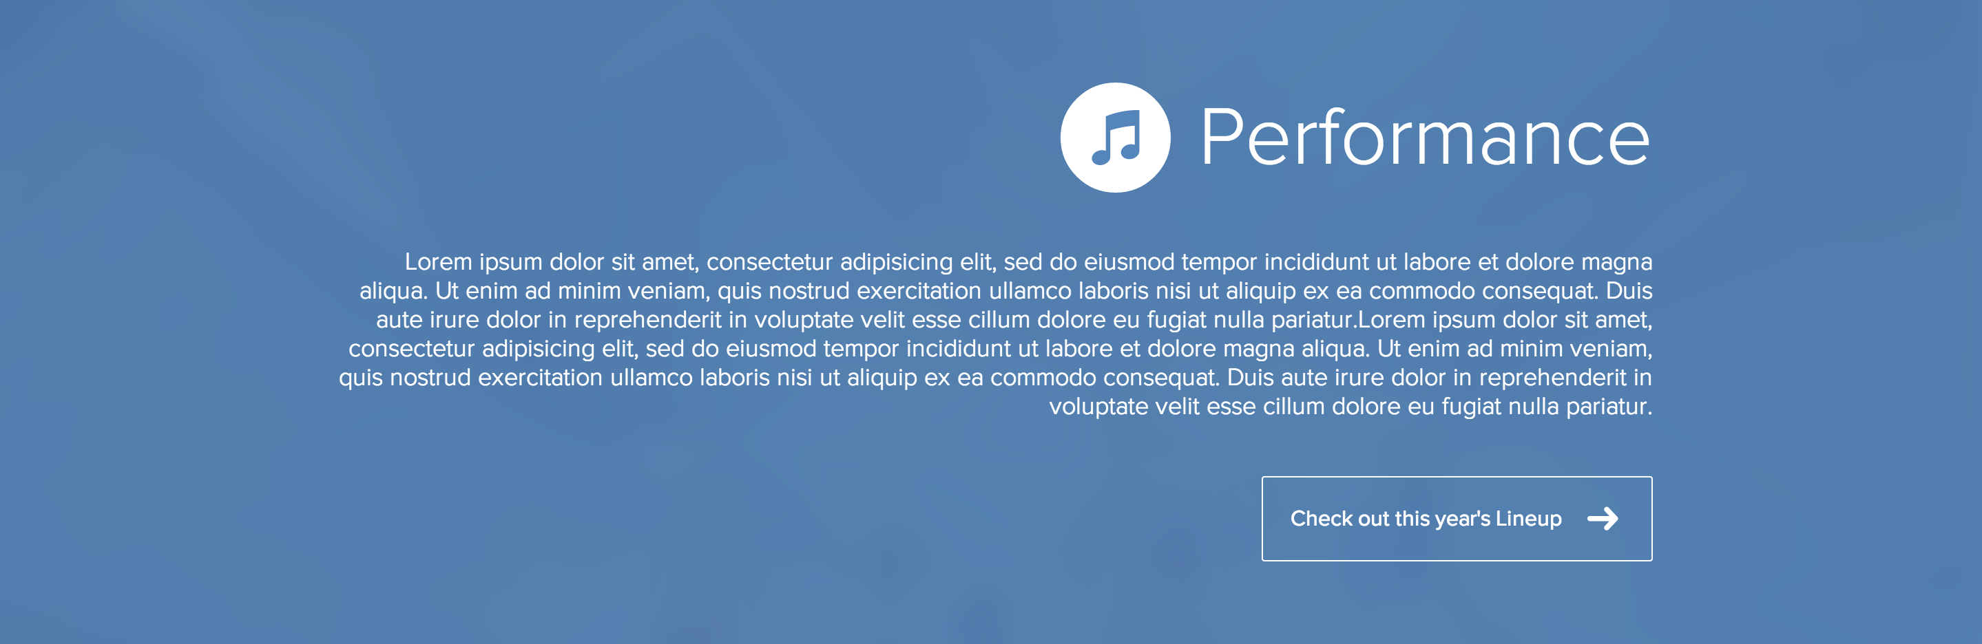
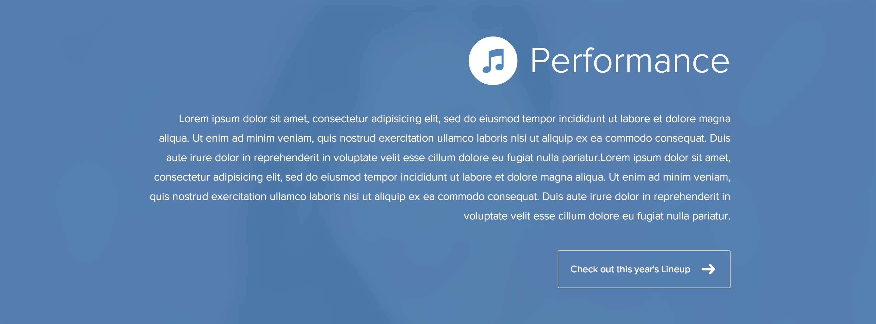
Line-spacing: normal
Line-spacing: 32px
Effect of Line Spacing
Notes:
JS-equivalent of the elements tab
Try out a code before actually going into the code editor

Slide 25
Paragraph Width
When the width of your paragraph gets too long, it becomes hard to read.
Usually 640px – 720px is the limit of “legible” paragraph.
Use “containers” to restrict the width of your text

Slide 26
How to practice spacing
1. Look at a lot other websites: what kind of metrics do they use?
2. Experiment: Try out a padding & margin.
3. Iterate: Ask for feedback, don’t be afraid to scrap.

Slide 27
Simple is not barren
It’s important not to overuse spacing
Run into issues where your UI looks “barren”
There is no golden rule for maintaining the balance
A lot of this comes from experience & looking at other designs
Use white-space judiciously depending on the purpose of your website.
Application: Less white-space ( ~ 20px padding )
Promotional: More white-space ( ~ 60px padding )
Cluttered
Barren
Simple

Slide 28
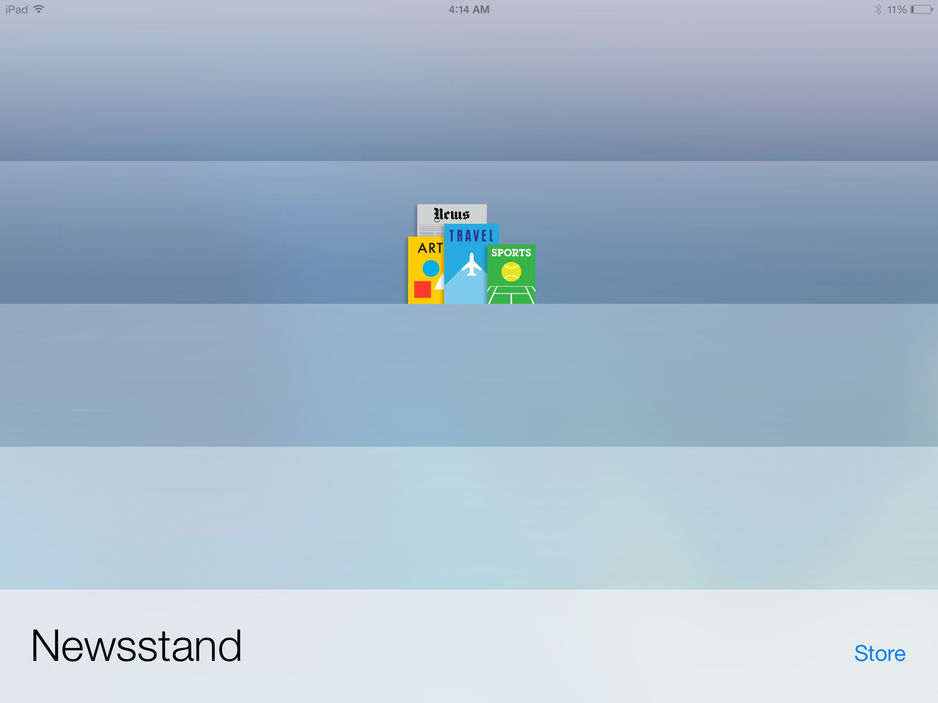
Barren not Simple: iOS 7 Newsstand

Slide 29
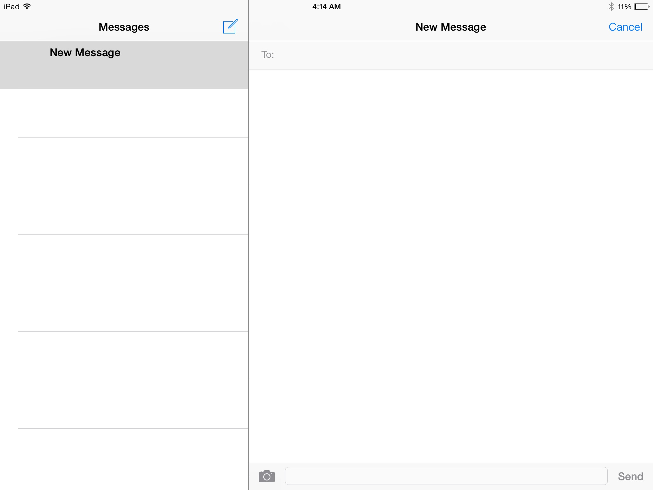
Barren not Simple: iOS 7 Messages

Slide 30
Review
Macro-level spacing
Gives an element a structure & “room to breathe”
Padding: Spacing within an element
Margin: Spacing between elements
Micro-level spacing
Influences the legibility of text
Make sure your spacing makes your UI simple, but not barren.

